Slide 1
Gaussian Processes
Regression, Classification & Optimization
2019. 1. 23
김 홍 배

Slide 2
Why GPs ? :
- Provide Closed-Form Predictions !
- Effective for small data problems
- And Explainable !

Slide 3
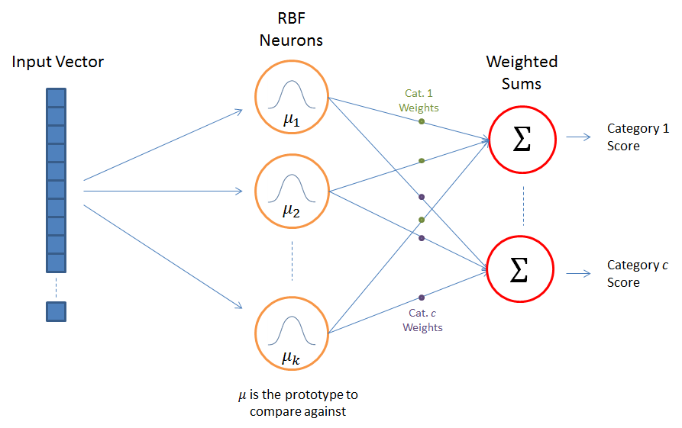
Radial Basis Function :
a kind of GP, kernel trick
Old but still useful !

Slide 4
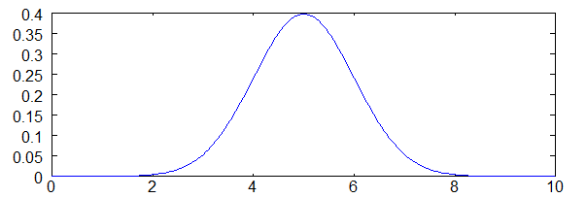
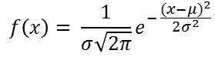
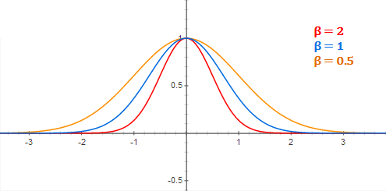
RBF(Gaussian kernel) example

Slide 5
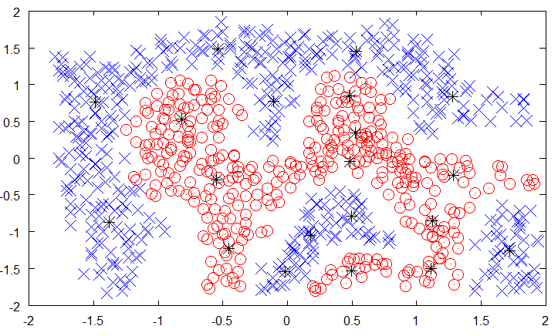
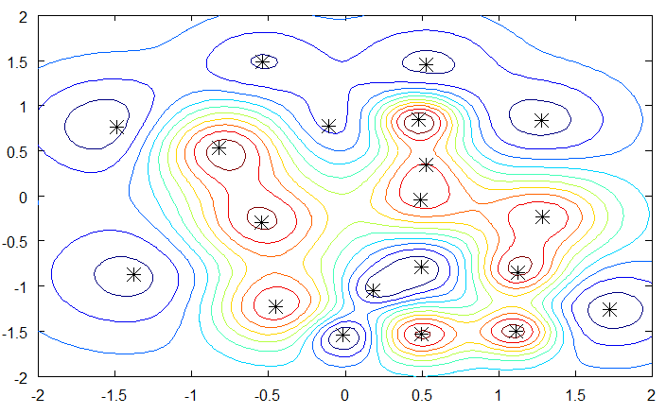
Application to Anomaly Detection, Classification

Slide 6
Optimal Data Sampling Strategy !

Slide 7
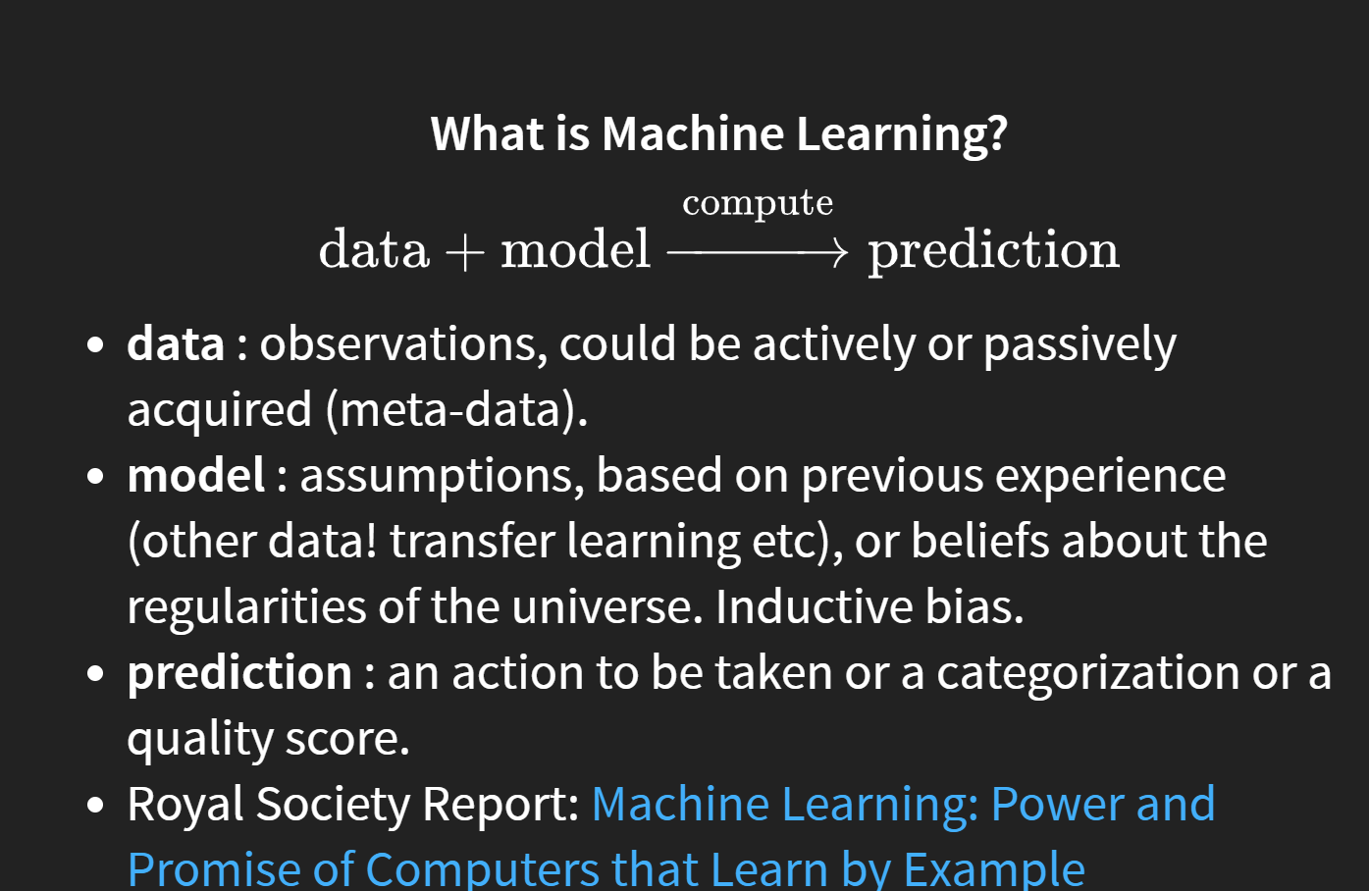

Slide 8
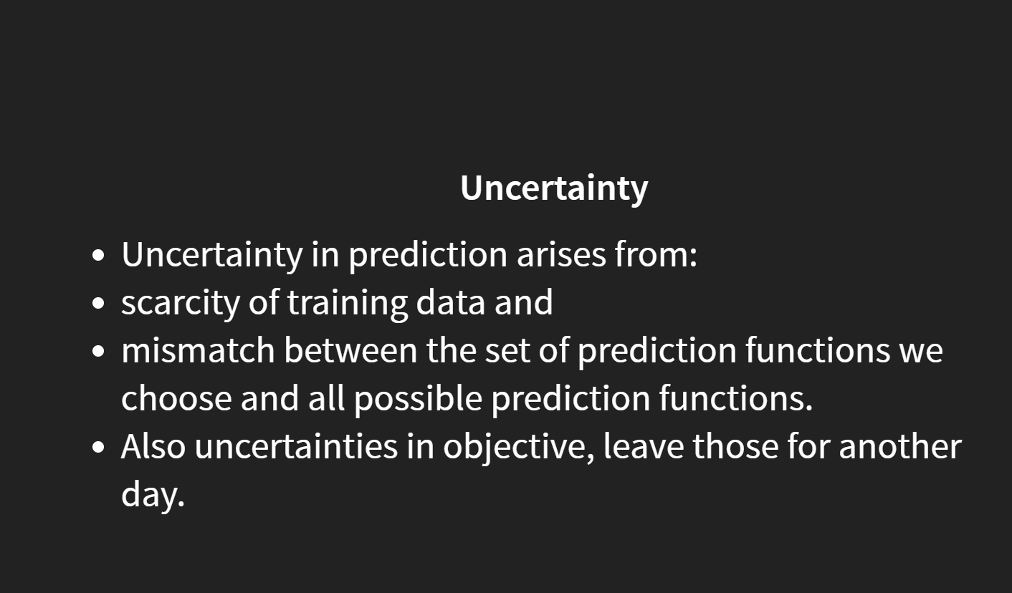

Slide 9
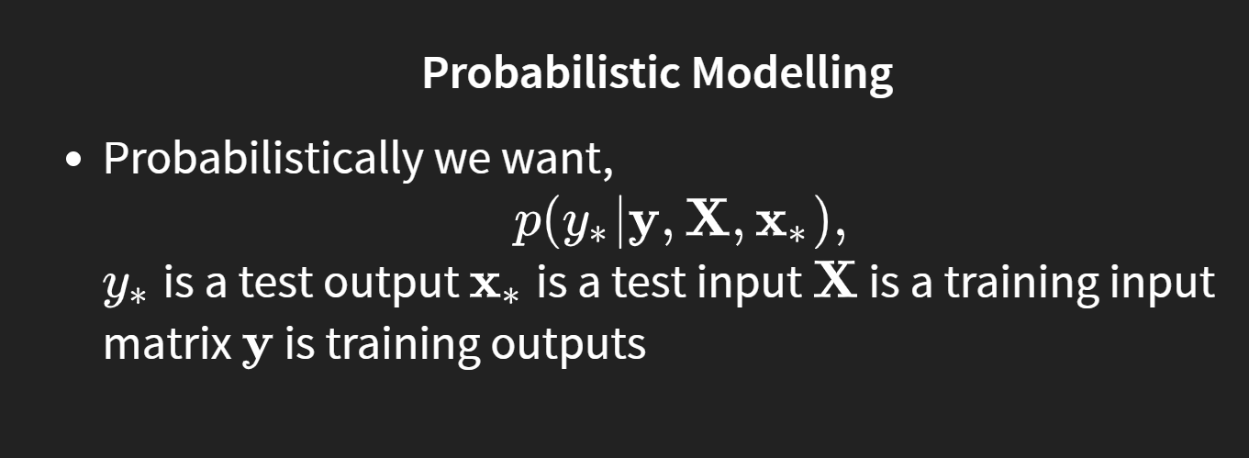

Slide 10
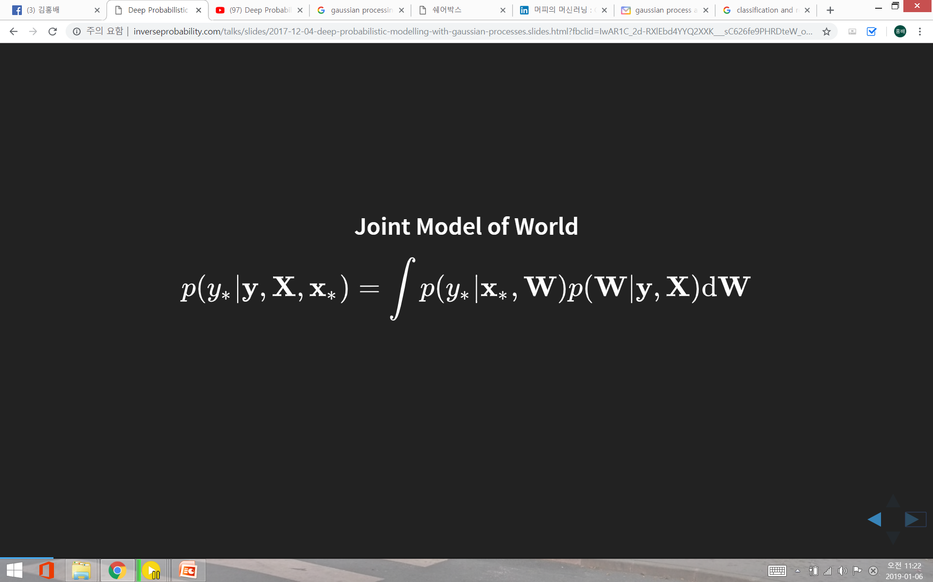
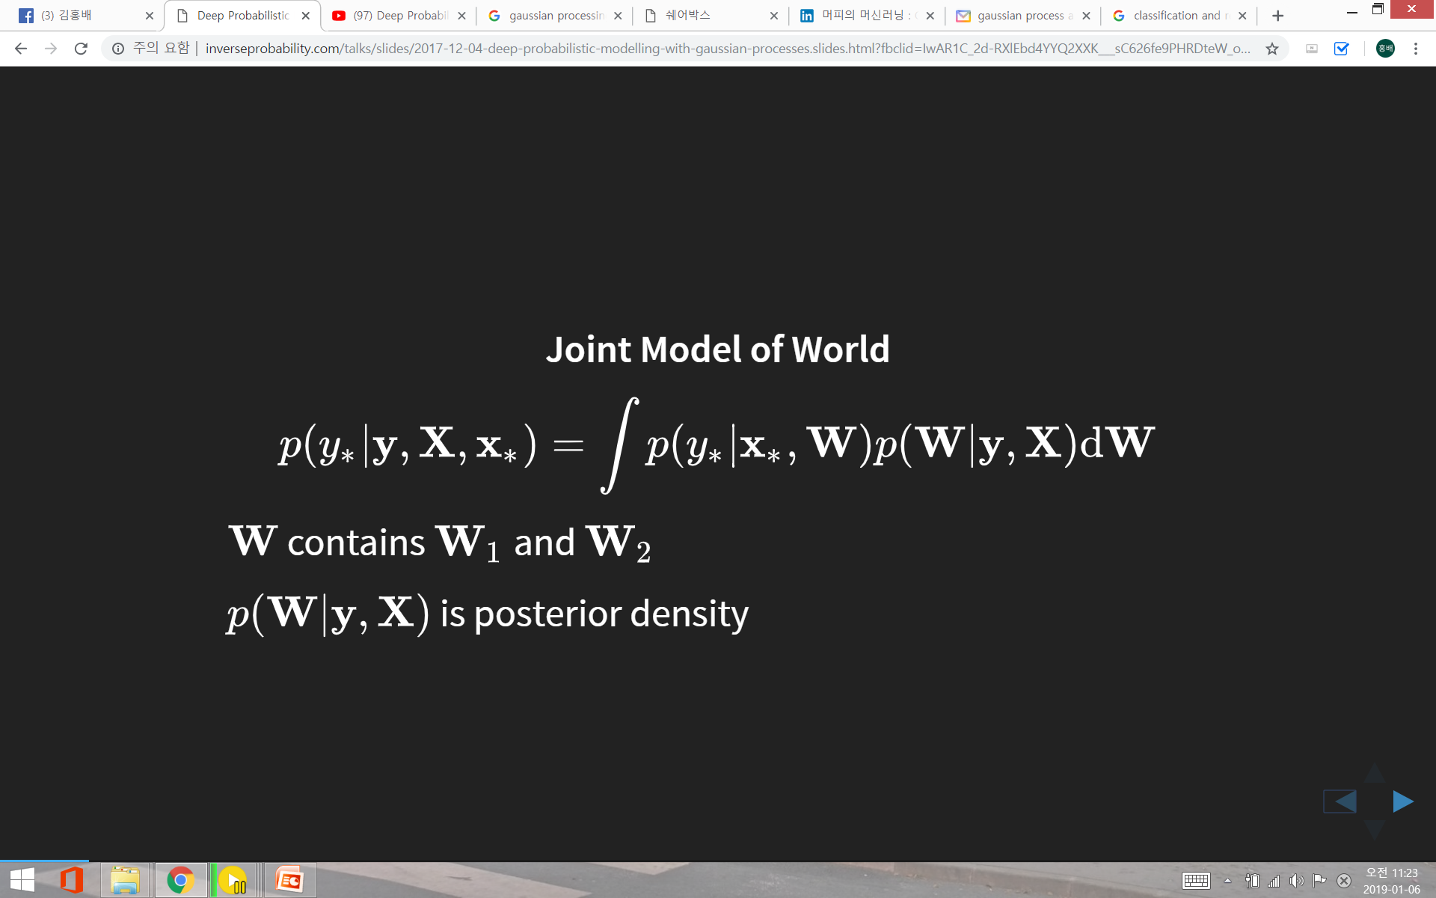
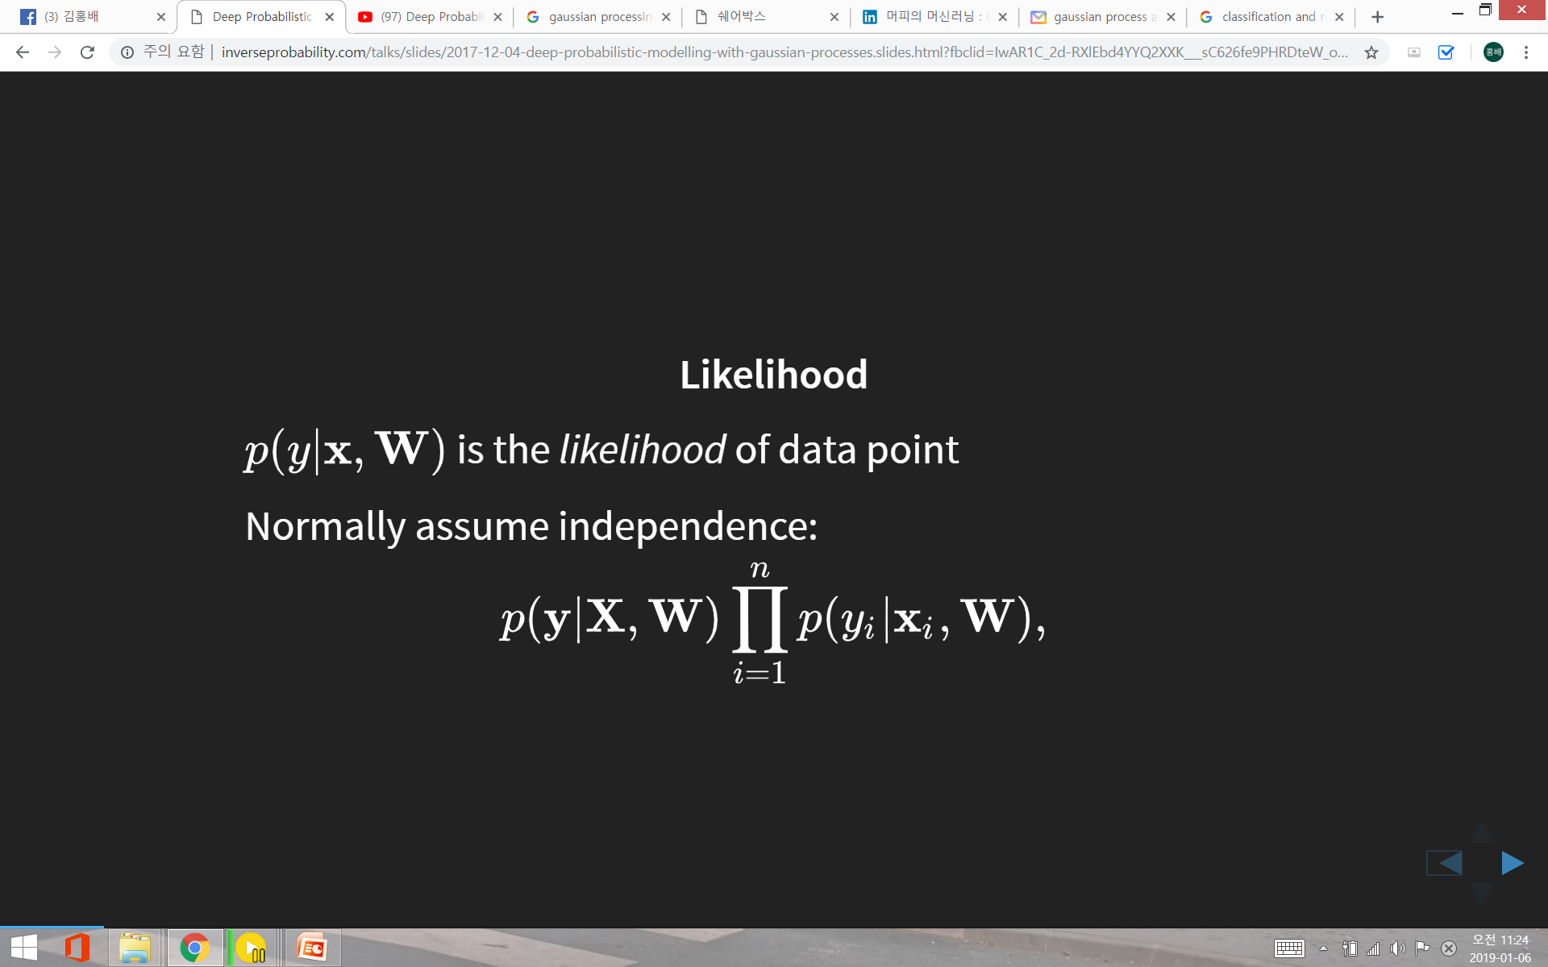
Difficult to tangle !

Slide 11
How Do We Deal With Many Parameters, Little Data ?
1. Regularization
e.g., smoothing, L1 penalty, drop out in neural nets, large K
for K-nearest neighbor
2. Standard Bayesian approach
specify probability of data given weights, P(D|W)
specify weight priors given hyper-parameter α, P(W|α)
find posterior over weights given data, P(W|D, α)
With little data, strong weight prior constrains inference
3. Gaussian processes
place a prior over functions, p(f) directly rather than
over model parameters, p(w)

Slide 12
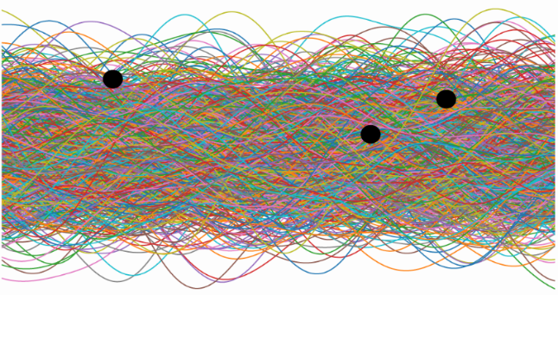
Functions : Relationship between Input and Output
Distribution of functions that satisfy
within the range of Input, X and Output, f
➔ Prior over functions, No Constraints
f
X
prior

Slide 13
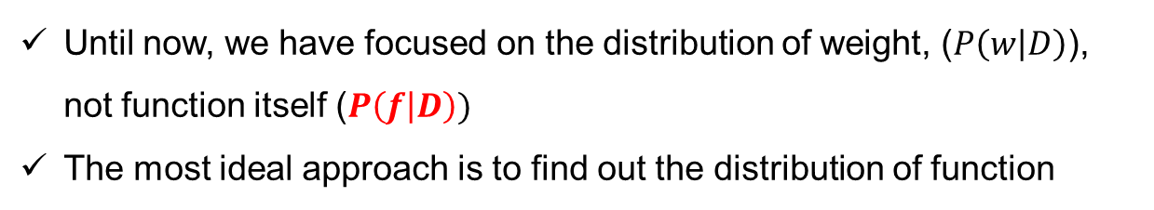
Gaussian Process Approach
Until now, we have focused on the distribution of weight, ($P\left(w | D\right)$), not function itself ($P\left(f | D\right))$
The most ideal approach is to find out the distribution of function
Consider the problem of nonlinear regression:
You want to learn a function f with error bars from data D = {X, y}
A Gaussian process defines a distribution over functions p(f) which can be used for Bayesian regression
~ p(D|f) p(f)

Slide 14
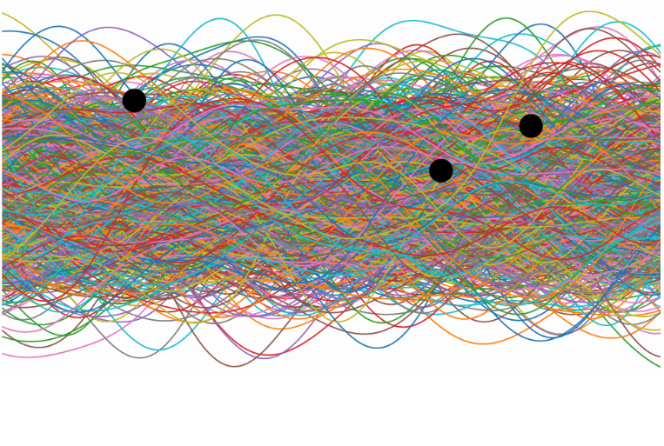
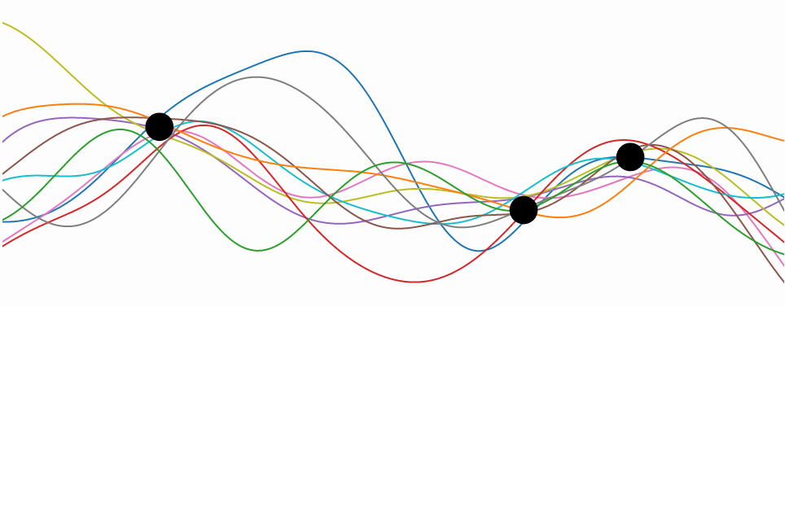
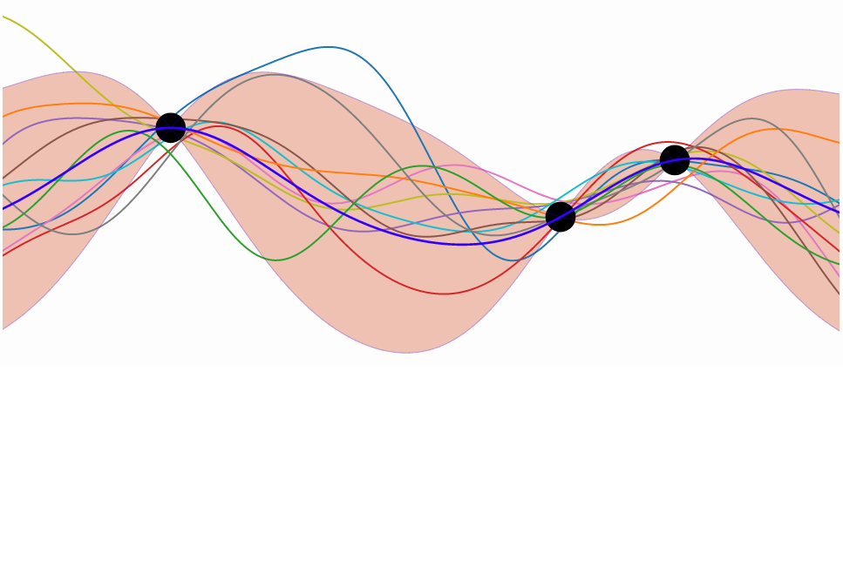
Gaussian Process Approach
GP specifies a prior over functions, f(x)
Suppose we have a set of observations:
D = {(x₁,y₁), (x₂, y₂), (x₃, y₃), …, (x_{n}, y_{n})}
Standard Bayesian approach
p(f|D) ~ p(D|f) p(f)
prior
One view of Bayesian inference
generating samples (the prior)
discard all samples inconsistent with our data, leaving the samples of interest (the posterior)
The Gaussian process allows us to do this analytically.
posterior

Slide 15
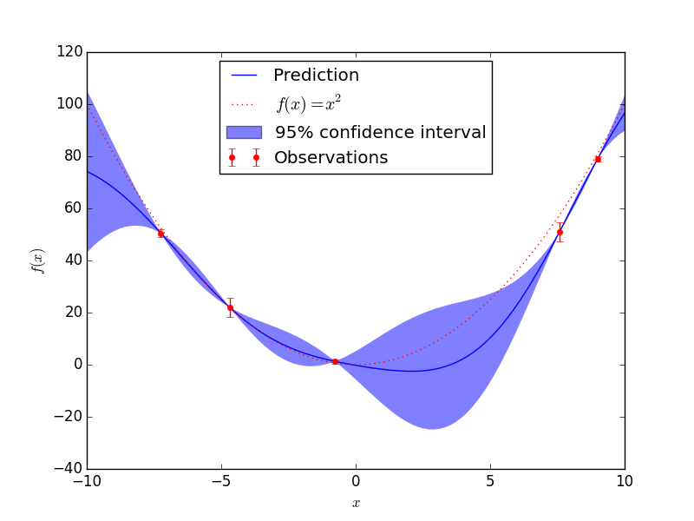
Gaussian Process Approach
Bayesian data modeling technique that account for uncertainty
Bayesian kernel regression machines

Slide 16
Gaussian Process
A Gaussian process is defined as a probability distribution over function f(x), such that the set of values of f(x) evaluated at an arbitrary set of points x₁,..,x_{n} jointly have a Gaussian distribution

Slide 17
Two input vectors are close ➔ There outputs are highly correlated
Two input vectors are far away ➔ There outputs are uncorrelated

Slide 19
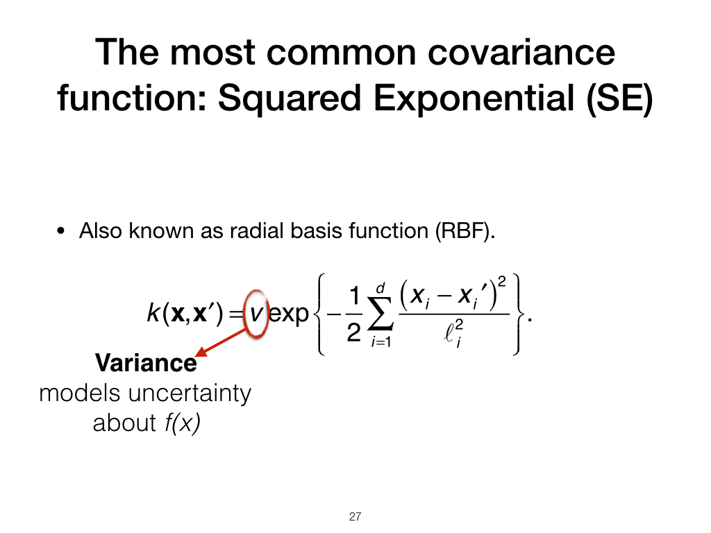
Distance bw. inputs
If (x-x’) ~ 0 ➔ k(x,x’) ~ v
If (x-x’) →∞ ➔ k(x,x’) → 0

Slide 20
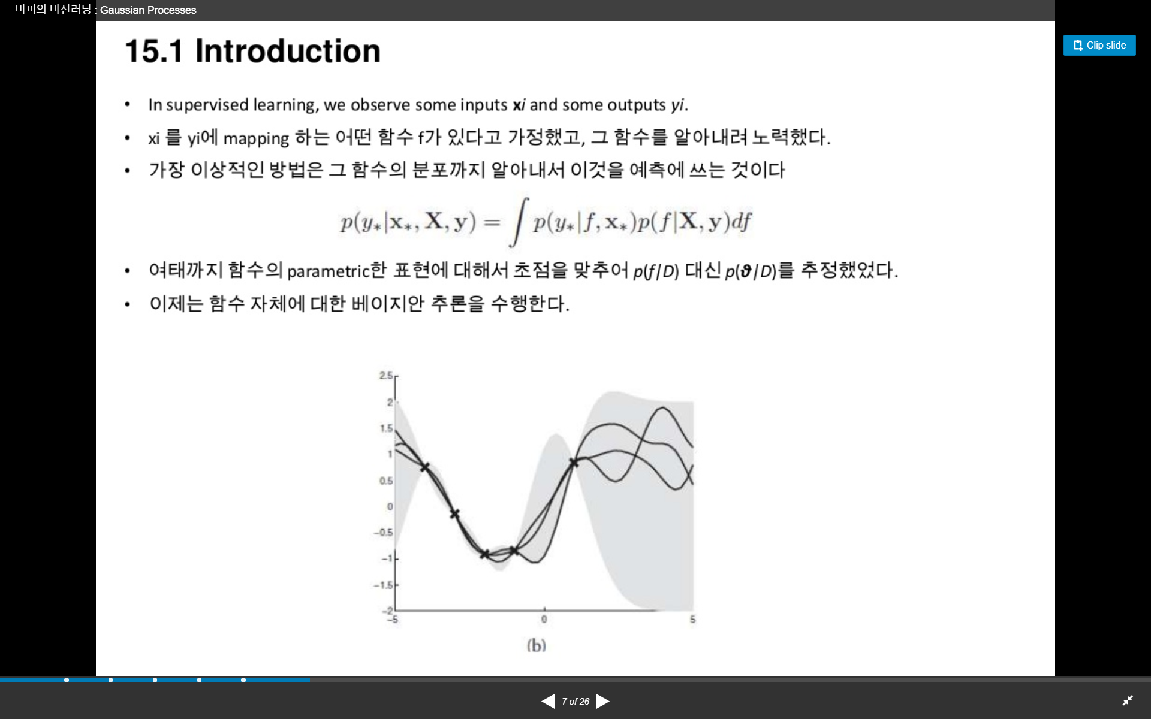
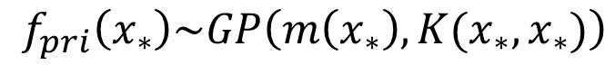
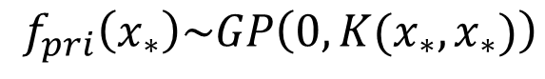
Prior Distribution of Function
Sampling from the prior distribution of a GP at arbitrary points, X*
$$f_{pri}\left(x_{∗}\right)\sim GP\left(m\left(x_{∗}\right), K(x_{∗},x_{∗})\right)$$
Without loss of generality, $assume m\left(x\right)=0,$Var($K(x_{∗},x_{∗})$) =1
$$f_{pri}\left(x_{∗}\right)\sim GP\left(0, K(x_{∗},x_{∗})\right)$$
Function depends only on the Covariance !!

Slide 21
Procedure to sample
1. Let’s assume input, X and function, f distributed as follows
f
X
2. Compute Covariance Matrix for a given $X=\left\{\begin{matrix}x_{1} & …. & x_{n}\end{matrix}\right\}$

Slide 22
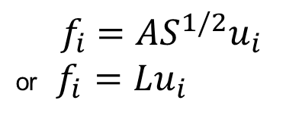
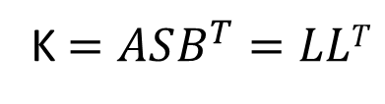
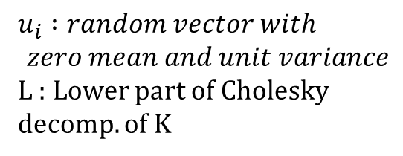
Procedure to sample
3. Compute SVD or Cholesky decomp. of K to get orthogonal basis functions
K $=ASB^{T}=LLT$
4. Compute Basis Function
$$u_{i} :random vector with$$
$$zero mean and unit variance$$
L : Lower part of Cholesky decomp. of K
$${ f}_{i} =AS^{1/2}u_{i}$$
or $f_{i}=Lu_{i}$
f
f
X
X
prior
posterior

Slide 23
Set the parameters of the covariance function
Set the points where the function will be evaluated
Calculate the Cholesky decomposition of the covariance function (add 10⁻⁹ to the diagonal to ensure positive definiteness).
Mean of the GP (set to zero)
Generate all the possible pairs of points
Calculate the covariance function for all the possible pairs of points
Generate independent pseudorandom numbers drawn from the standard normal distribution.
Compute f which has the desired distribution with mean and covariance

Slide 24
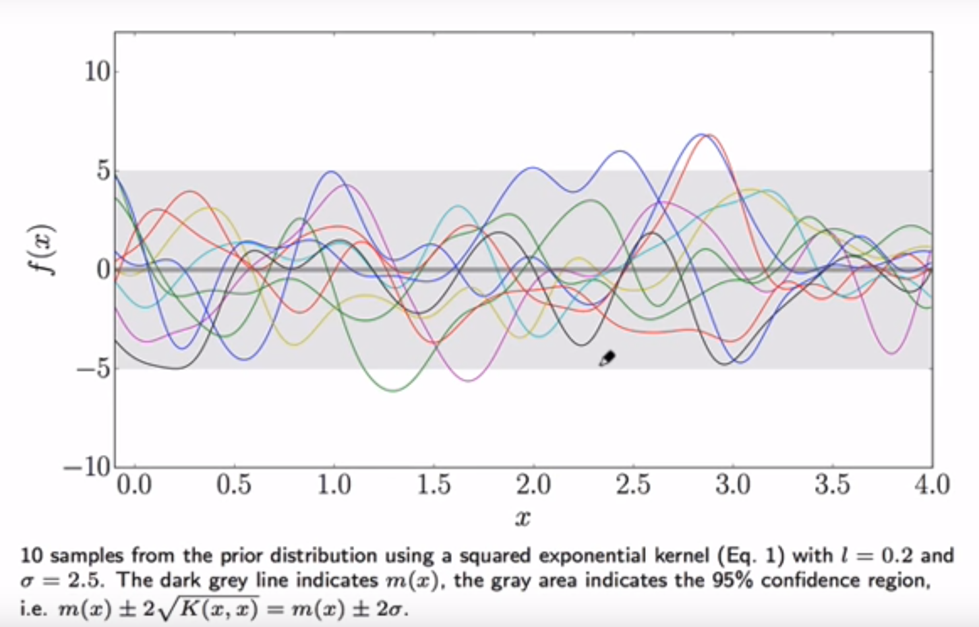
Drawing samples from the prior

Slide 25
NxN matrix N*xN matrix NxN* matrix N*xN* matrix

Slide 28
Testing points range from -10 ~ 10
4 observations (training points)
Calculate the partitions of the joint covariance matrix
Cholesky decomposition of K(X,X) – training of GP Complexity O(N3)
Calculate predictive distribution ComplexityO(N2)

Slide 30
Samples from the posterior pass close to the observations, but vary a lot in regions where are no observations.

Slide 35
Standard deviation of the noise on the observation
Add the noise to the diagonal of K(X,X)

Slide 44
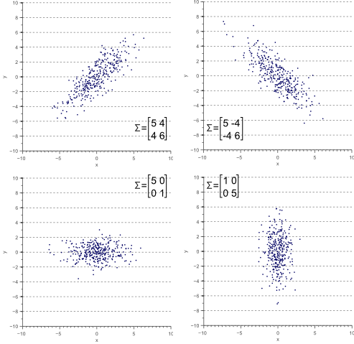
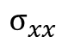
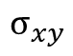
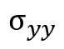
Covariance matrix defines the shape of the data
$$σ_{yy}$$
$$σ_{xy}$$
$$σ_{xx}$$
Diagonal spread is captured by the covariance,
while axis-aligned spread is captured by the variance.

Slide 45
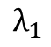
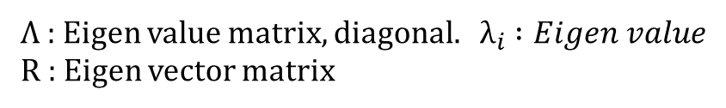
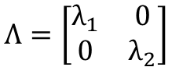
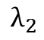
Eigen-decomposition of a covariance matrix
The largest eigenvector of the covariance matrix always points into the direction of the largest variance of the data, and the magnitude of this vector equals the corresponding eigenvalue.
The second largest eigenvector is always orthogonal to the largest eigenvector, and points into the direction of the second largest spread of the data.
Σ = RΛR^{T}
$$Λ=\left[\begin{matrix}λ_{1} & 0 \\ 0 & λ_{2}\end{matrix}\right]$$
Λ : Eigen value matrix, diagonal. $λ_{i} :Eigen value$
R : Eigen vector matrix
$$λ_{1}$$
$$λ_{2}$$
Diagonal of Λ represents distance along axes.
R gives a rotation of these axes

Slide 46
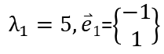
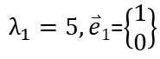
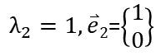
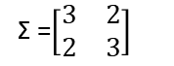
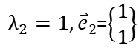
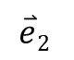
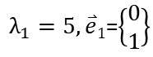
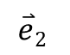
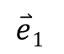
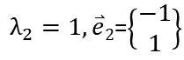
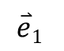
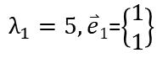
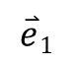
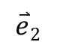
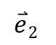
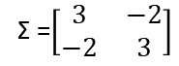


$λ_{1}=5, \overset{⃑}{e}1$=$\left\{\begin{matrix}−1 \\ 1\end{matrix}\right\}$
$λ_{2}=1, \overset{⃑}{e}2$=$\left\{\begin{matrix}1 \\ 1\end{matrix}\right\}$
$λ_{2}=1, \overset{⃑}{e}2$=$\left\{\begin{matrix}−1 \\ 1\end{matrix}\right\}$
$λ_{1}=5, \overset{⃑}{e}1$=$\left\{\begin{matrix}1 \\ 1\end{matrix}\right\}$
$$\overset{⃑}{e}2$$
$$\overset{⃑}{e}1$$
$$\overset{⃑}{e}1$$
$$\overset{⃑}{e}2$$
Σ =$\left[\begin{matrix}3 & 2 \\ 2 & 3\end{matrix}\right]$
Σ =$\left[\begin{matrix}3 & −2 \\ −2 & 3\end{matrix}\right]$
$λ_{2}=1, \overset{⃑}{e}2$=$\left\{\begin{matrix}0 \\ 1\end{matrix}\right\}$
$λ_{1}=5, \overset{⃑}{e}1$=$\left\{\begin{matrix}1 \\ 0\end{matrix}\right\}$
$λ_{1}=5, \overset{⃑}{e}1$=$\left\{\begin{matrix}0 \\ 1\end{matrix}\right\}$
$$\overset{⃑}{e}2$$
$$\overset{⃑}{e}1$$
$λ_{2}=1, \overset{⃑}{e}2$=$\left\{\begin{matrix}1 \\ 0\end{matrix}\right\}$
$$\overset{⃑}{e}1$$
$$\overset{⃑}{e}2$$

Slide 47


A geometric interpretation of the covariance matrix
Gaussian density function
Variance

Slide 48



covariance
covariance matrix
covariance matrix is always a symmetric matrix with the variances on its diagonal and the covariances off-diagonal

Slide 49


Slide 50




Slide 51

Conditionals of multivariate Gaussians are Gaussian

Slide 52



Covariance Function
x’
Σ =$\left[\begin{matrix}3 & 2 \\ 2 & 3\end{matrix}\right]$
x
x’
x’
Σ =$\left[\begin{matrix}5 & 0 \\ 0 & 3\end{matrix}\right]$
Σ =$\left[\begin{matrix}1 & 0 \\ 0 & 5\end{matrix}\right]$
x
x

Slide 53


Covariance Function
x²
x²
Σ =$\left[\begin{matrix}3 & 2 \\ 2 & 3\end{matrix}\right]$
Σ =$\left[\begin{matrix}5 & 0 \\ 0 & 3\end{matrix}\right]$
x¹
x¹
x¹
x²
x¹
x²

